Slide 1
Chapter 5: CPU Scheduling
(Galvin book)

Slide 2
Schedulers
Long-term scheduler (or job scheduler) – selects which processes should be brought into the ready queue
Medium term scheduler: which determines when processes are to be suspended and resumed;
Short-term scheduler (or CPU scheduler) – selects which process should be executed next and allocates CPU
  Sometimes the only scheduler in a system

Slide 3
Schedulers (Cont.)
Short-term scheduler is invoked very frequently (milliseconds) ⇒ (must be fast)
Long-term scheduler is invoked very infrequently (seconds, minutes) ⇒ (may be slow)
The long-term scheduler controls the degree of multiprogramming
Processes can be described as either:
  I/O-bound process – spends more time doing I/O than computations, many short CPU bursts
  CPU-bound process – spends more time doing computations; few very long CPU bursts

Slide 4
Chapter 5: CPU Scheduling
Basic Concepts
Scheduling Criteria
Scheduling Algorithms
Thread Scheduling
Multiple-Processor Scheduling
Operating Systems Examples
Algorithm Evaluation

Slide 5
Objectives
To introduce CPU scheduling, which is the basis for multiprogrammed operating systems
To describe various CPU-scheduling algorithms
To discuss evaluation criteria for selecting a CPU-scheduling algorithm for a particular system

Slide 6
Basic Concepts
Maximum CPU utilization obtained with multiprogramming
CPU–I/O Burst Cycle – Process execution consists of a cycle of CPU execution and I/O wait
CPU burst distribution

Slide 7

Alternating Sequence of CPU and
I/O Bursts

Slide 8
CPU Scheduler
Selects from among the processes in ready queue, and allocates the CPU to one of them
  Queue may be ordered in various ways
CPU scheduling decisions may take place when a process:
  1. Switches from running to blocked/waiting state
  2. Switches from running to ready state
  3. Switches from blocked/waiting to ready
  Terminates

Slide 9
Dispatcher
Dispatcher module gives control of the CPU to the process selected by the short-term scheduler; this involves:
  switching context
  switching to user mode
  jumping to the proper location in the user program to restart that program
Dispatch latency – time it takes for the dispatcher to stop one process and start another running

Slide 10
Scheduling Criteria
CPU utilization – keep the CPU as busy as possible
Throughput – # of processes that complete their execution per time unit
Turnaround time – amount of time to execute a particular process
  Turnaround time =terminated time – arrival time
Waiting time – amount of time a process has been waiting in the ready queue
  Waiting time= Turnaround time – execution time/processing time
Response time – amount of time it takes from when a request was submitted until the first response is produced, not output (for time-sharing environment)

Slide 11
Scheduling Algorithm Optimization Criteria
Max CPU utilization
Max throughput
Min turnaround time
Min waiting time
Min response time

Slide 12
First-Come, First-Served (FCFS) Scheduling
Process Burst Time/ execution time
P₁ 24
P₂ 3
P₃ 3
Suppose that the processes arrive in the order: P₁ , P₂ , P₃
The Gantt Chart for the schedule is:
Waiting time for P₁ = 0; P₂ = 24; P₃ = 27
Average waiting time: (0 + 24 + 27)/3 = 17
TAT:
P1=24-0=24
P2=27-0=27
P3=30-0=30
Avg TAT=(24+27+30)/3
WAIT TIME:
P1=24-24=0
P2=27-3=24
P3=30-3=27
Avg WAIT TIME=
(0+24+27)/3=51/3=17
P₁
P₂
P₃
0
24
27
30

Slide 13
FCFS Scheduling (Cont.)
Suppose that the processes arrive in the order:
P₂ , P₃ , P₁
The Gantt chart for the schedule is:
Waiting time for P₁ = 6; P₂ = 0; P₃ = 3
Average waiting time: (6 + 0 + 3)/3 = 3
Much better than previous case
Convoy effect - short process behind long process
  Consider one CPU-bound and many I/O-bound processes
P₂
P₃
P₁
0
3
6
30

Slide 14
Shortest-Job-First (SJF) Scheduling
Associate with each process the length of its next CPU burst
  Use these lengths to schedule the process with the shortest time
SJF is optimal – gives minimum average waiting time for a given set of processes
  The difficulty is knowing the length of the next CPU request
  Could ask the user

Slide 15
Example of SJF
TAT:
P1=9-0=9
P2=24-0=24
P3=16-0=16
P4=3-0=3
WAIT TIME:
P1=9-6=3
P2=24-8=16
P3=16-7=9
P4=3-3=0
Avg WAIT TIME=
(3+16+9+0)/4=7
ProcessArriva l Time Burst Time / execution time
P₁ 0.0 6
P₂ 2.0 8
P₃ 4.0 7
P₄ 5.0 3
SJF scheduling chart
Average waiting time = (3 + 16 + 9 + 0) / 4 = 7
P₄
P₁
P₃
P₂
0
3
9
16
24

Slide 16
Example of Shortest-remaining-time-first shortest job first(pre-emptive)
Now we add the concepts of varying arrival times and preemption to the analysis
ProcessA arri Arrival TimeT Burst Time
P₁ 0 8
P₂ 1 4
P₃ 2 9
P₄ 3 5
Preemptive SJF Gantt Chart
Average waiting time = [(10-1)+(1-1)+(17-2)+5-3)]/4 = 26/4 = 6.5 msec
TAT
P1=17-0=17
P2=5-1=4
P3=26-2=24
P4=10-3=7
WAIT TIME
P1=17-8=9
P2=4-4=0
P3=24-9=15
P4=7-5=2
Average Wait Time
=(9+0+15+2)/4
=26/4=6.5
P1=8-1=7
P2=
P3=9
P4=5
P₁
P₂
P₄
P₁
P₃
0
1
5
10
17
26

Slide 17
Registarationid-Name-OSTask1
ghazanfar.assignment@gmail.com
For the processes listed in the table as shown below, draw a chart illustrating its execution using Shortest remaining time first. Also find average turnaround time and average wait time.
Process | Arrival time | Processing time
A | 0 | 6
B | 1 | 3
C | 2 | 2
D | 4 | 3
E | 5 | 2

Slide 18
Priority Scheduling
A priority number (integer) is associated with each process
The CPU is allocated to the process with the highest priority (smallest integer ≡ highest priority)
  Preemptive
  Nonpreemptive
SJF is priority scheduling where priority is the inverse of predicted next CPU burst time
Problem ≡ Starvation – low priority processes may never execute
Solution ≡ Aging – as time progresses increase the priority of the process

Slide 19
Example of Priority Scheduling (Non=preemptive)
ProcessA arri Burst TimeT Priority
P₁ 10 3
P₂ 1 1
P₃ 2 4
P₄ 1 5
P₅ 5 2
Priority scheduling Gantt Chart
Average waiting time = 8.2 msec
Turn Around Time=
P1=16-0=16
P2=1-
P3=0=1
P3=18
P4=19
P5=6
Wait time=
P1=16-10=6
P2=1-1=0
P3=18-4=14
P4=19-5=14
p5=6-2=4
P₂
P₅
P₁
P₃
P₄
0
1
6
16
18
19

Slide 20
Example of Priority Scheduling (preemptive)
ProcessA arri Burst TimeT Priority Arrival time
P₁ 10 3 0
P₂ 1 1 2
P₃ 2 4 4
P₄ 1 5 5
P₅ 5 2 6
Priority scheduling Gantt Chart

Slide 21
Round Robin (RR)
Each process gets a small unit of CPU time (time quantum q), usually 10-100 milliseconds. After this time has elapsed, the process is preempted and added to the end of the ready queue.
If there are n processes in the ready queue and the time quantum is q, then each process gets 1/n of the CPU time in chunks of at most q time units at once. No process waits more than (n-1)q time units.
Timer interrupts every quantum to schedule next process
Performance
  q large ⇒ FIFO
  q small ⇒ q must be large with respect to context switch, otherwise overhead is too high

Slide 22
Example of RR with Time Quantum = 4
Process Burst Time
P₁ 24
P₂ 3
P₃ 3
The Gantt chart is:
Typically, higher average turnaround than SJF, but better response
q should be large compared to context switch time
q usually 10ms to 100ms, context switch < 10 usec
P₁
P₂
P₃
P₁
P₁
P₁
P₁
P₁
0
4
7
10
14
18
22
26
30

Slide 23

Time Quantum and Context Switch Time

Slide 24

Turnaround Time Varies With
The Time Quantum
80% of CPU bursts should be shorter than q

Slide 25
Round Robin ( time quantum=2)
Process | Arrival time | Processing time
A | 0 | 5
B | 2 | 3
C | 3 | 2
D | 4 | 3

Slide 26
Multilevel Queue
Ready queue is partitioned into separate queues, eg:
  foreground (interactive)
  background (batch)
Process permanently in a given queue
Each queue has its own scheduling algorithm:
  foreground – RR
  background – FCFS
Scheduling must be done between the queues:
  Fixed priority scheduling; (i.e., serve all from foreground then from background). Possibility of starvation.
  Time slice – each queue gets a certain amount of CPU time which it can schedule amongst its processes; i.e., 80% to foreground in RR
  20% to background in FCFS

Slide 27
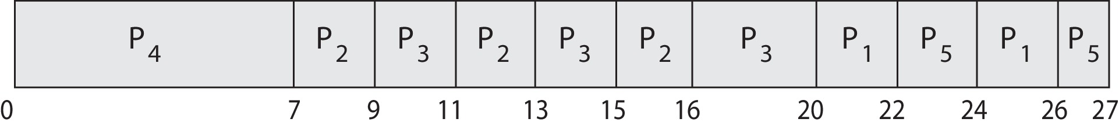
Priority Scheduling w/ Round-Robin
ProcessA arri Burst TimeT Priority
P₁ 4 3
P₂ 5 2
P₃ 8 2
P₄ 7 1
P₅ 3 3
Run the process with the highest priority. Processes with the same priority run round-robin
Gantt Chart with 2 ms time quantum

Slide 28
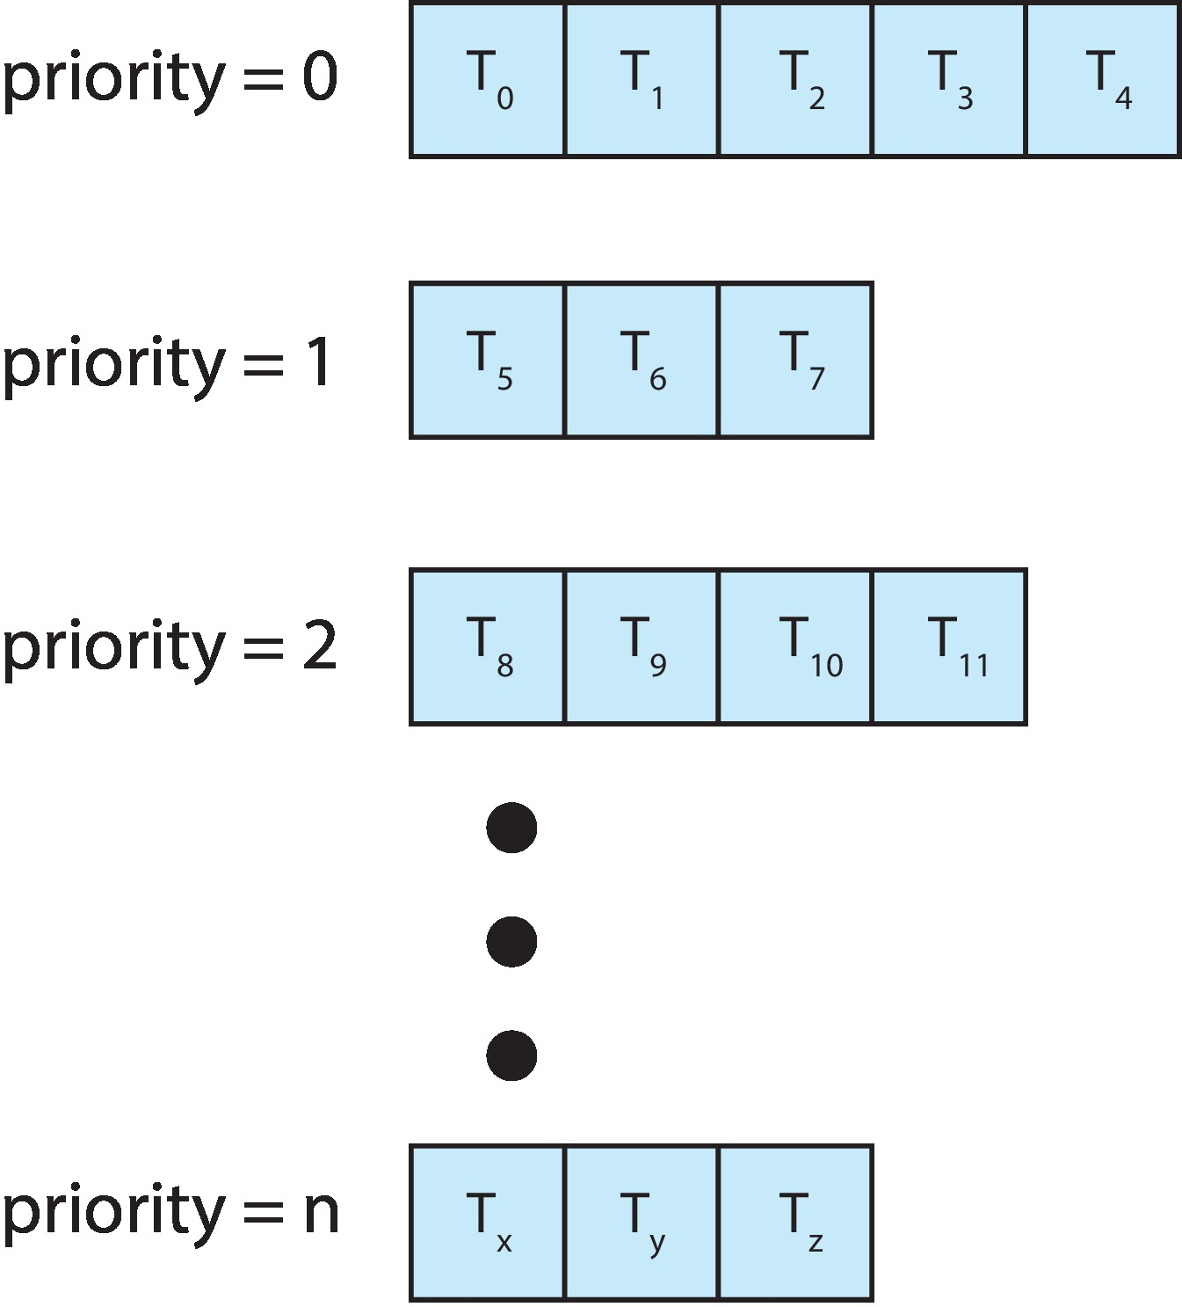
Multilevel Queue
With priority scheduling, have separate queues for each priority.
Schedule the process in the highest-priority queue!

Slide 29

Multilevel Queue Scheduling

Slide 30
Multilevel Feedback Queue
A process can move between the various queues; aging can be implemented this way
Multilevel-feedback-queue scheduler defined by the following parameters:
  number of queues
  scheduling algorithms for each queue
  method used to determine when to upgrade a process
  method used to determine when to demote a process
  method used to determine which queue a process will enter when that process needs service

Slide 31
Example of Multilevel Feedback Queue
Three queues:
  Q₀ – RR with time quantum 8 milliseconds
  Q₁ – RR time quantum 16 milliseconds
  Q₂ – FCFS
Scheduling
  A new job enters queue Q₀ which is served FCFS
    When it gains CPU, job receives 8 milliseconds
    If it does not finish in 8 milliseconds, job is moved to queue Q₁
  At Q₁ job is again served FCFS and receives 16 additional milliseconds
    If it still does not complete, it is preempted and moved to queue Q₂
    If a process does not use up its quantum in the current level, it will keep its current queuing level and be put into the end of the queue. Then, it can still get the same amount of quantum (not remaining quantum) next time when it is picked.

Slide 32

Multilevel Feedback Queues

Slide 33
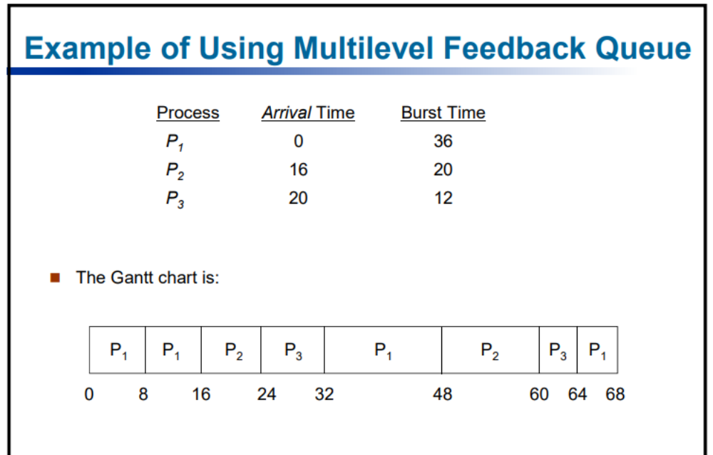

Slide 34
Assignment:
Implement CPU Scheduling algorithms
FCFS, SHORTEST JOB FIRST, Round Robin and Shortest Remaining Time first
Submission 7th April.
Draw Gantt chart and find Average wait time and average turn around time.

Slide 35
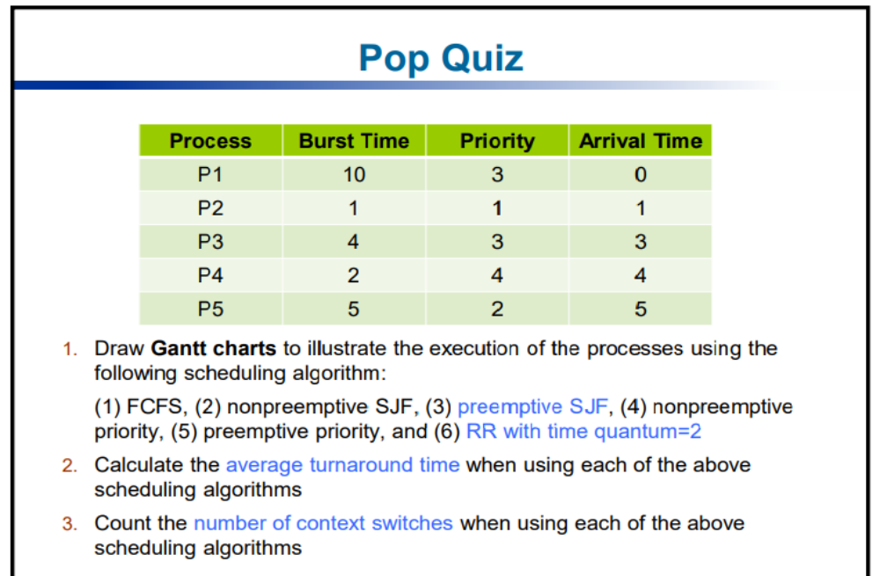

Slide 36
Thread Scheduling
Distinction between user-level and kernel-level threads
When threads supported, threads scheduled, not processes
Many-to-one and many-to-many models, thread library schedules user-level threads to run on LWP
  Known as process-contention scope (PCS) since scheduling competition is within the process
  Typically done via priority set by programmer
Kernel thread scheduled onto available CPU is system-contention scope (SCS) – competition among all threads in system

Slide 37
Multicore Processors
Recent trend to place multiple processor cores on same physical chip
Faster and consumes less power
Multiple threads per core also growing
  Takes advantage of memory stall to make progress on another thread while memory retrieve happens

Slide 38
Operating System Examples
Solaris scheduling
Windows XP scheduling
Linux scheduling

Slide 39
Solaris
Priority-based scheduling
Six classes available
  Time sharing (default)
  Interactive
  Real time
  System
  Fair Share
  Fixed priority
Given thread can be in one class at a time
Each class has its own scheduling algorithm
Time sharing is multi-level feedback queue
  Loadable table configurable by sysadmin

Slide 40
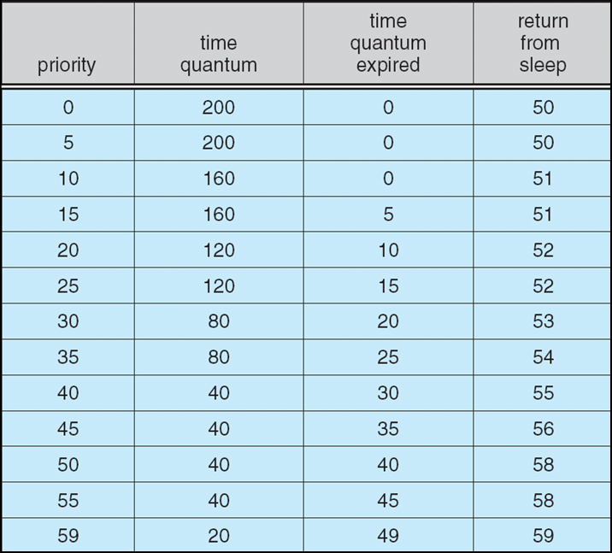
Solaris Dispatch Table

Slide 41
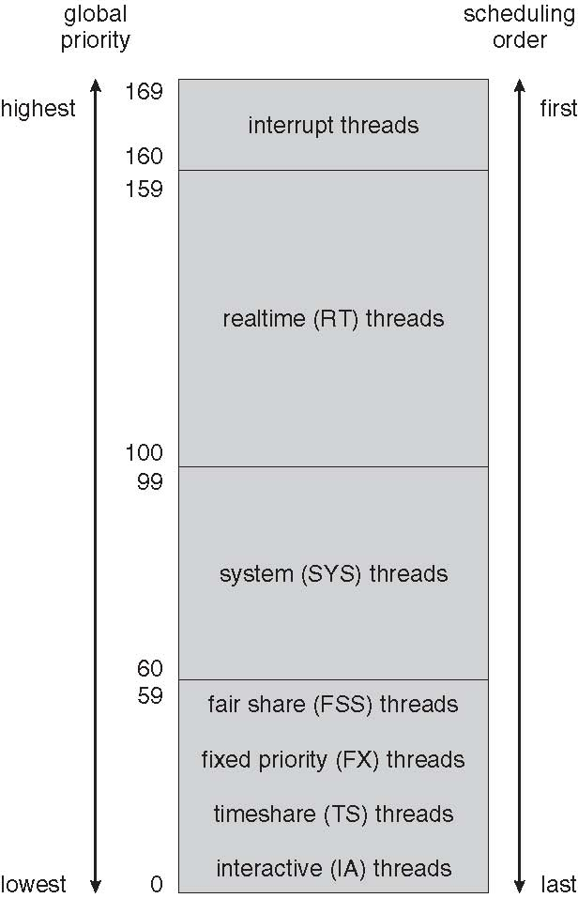
Solaris Scheduling

Slide 42
Solaris Scheduling (Cont.)
Scheduler converts class-specific priorities into a per-thread global priority
  Thread with highest priority runs next
  Runs until (1) blocks, (2) uses time slice, (3) preempted by higher-priority thread
  Multiple threads at same priority selected via RR

Slide 43
Windows Scheduling
Windows uses priority-based preemptive scheduling
Highest-priority thread runs next
Dispatcher is scheduler
Thread runs until (1) blocks, (2) uses time slice, (3) preempted by higher-priority thread
Real-time threads can preempt non-real-time
32-level priority scheme
Variable class is 1-15, real-time class is 16-31
Priority 0 is memory-management thread
Queue for each priority
If no run-able thread, runs idle thread

Slide 44
Windows Priority Classes
Win32 API identifies several priority classes to which a process can belong
  REALTIME_PRIORITY_CLASS, HIGH_PRIORITY_CLASS, ABOVE_NORMAL_PRIORITY_CLASS,NORMAL_PRIORITY_CLASS, BELOW_NORMAL_PRIORITY_CLASS, IDLE_PRIORITY_CLASS
  All are variable except REALTIME
A thread within a given priority class has a relative priority
  TIME_CRITICAL, HIGHEST, ABOVE_NORMAL, NORMAL, BELOW_NORMAL, LOWEST, IDLE
Priority class and relative priority combine to give numeric priority
Base priority is NORMAL within the class
If quantum expires, priority lowered, but never below base
If wait occurs, priority boosted depending on what was waited for
Foreground window given 3x priority boost

Slide 45
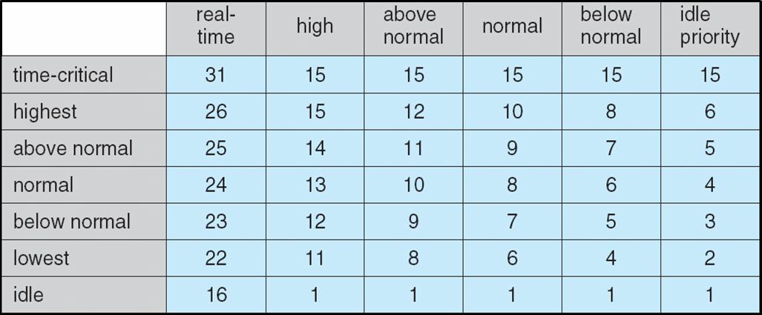
Windows XP Priorities

Slide 46
Linux Scheduling
Constant order O(1) scheduling time
Preemptive, priority based
Two priority ranges: time-sharing and real-time
Real-time range from 0 to 99 and nice value from 100 to 140
Map into global priority with numerically lower values indicating higher priority
Higher priority gets larger q
Task run-able as long as time left in time slice (active)
If no time left (expired), not run-able until all other tasks use their slices
All run-able tasks tracked in per-CPU runqueue data structure
  Two priority arrays (active, expired)
  Tasks indexed by priority
  When no more active, arrays are exchanged

Slide 47
Linux Scheduling (Cont.)
Real-time scheduling according to POSIX.1b
  Real-time tasks have static priorities
All other tasks dynamic based on nice value plus or minus 5
  Interactivity of task determines plus or minus
    More interactive -> more minus
  Priority recalculated when task expired
  This exchanging arrays implements adjusted priorities

Slide 48
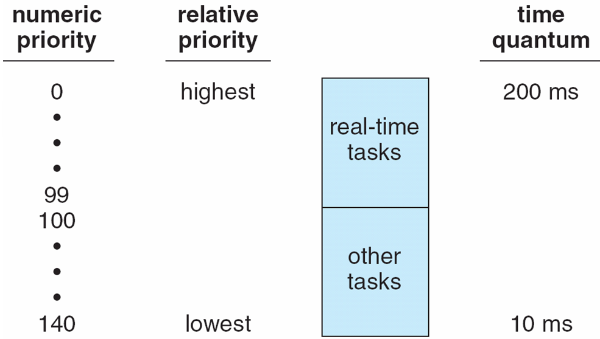
Priorities and Time-slice length

Slide 49
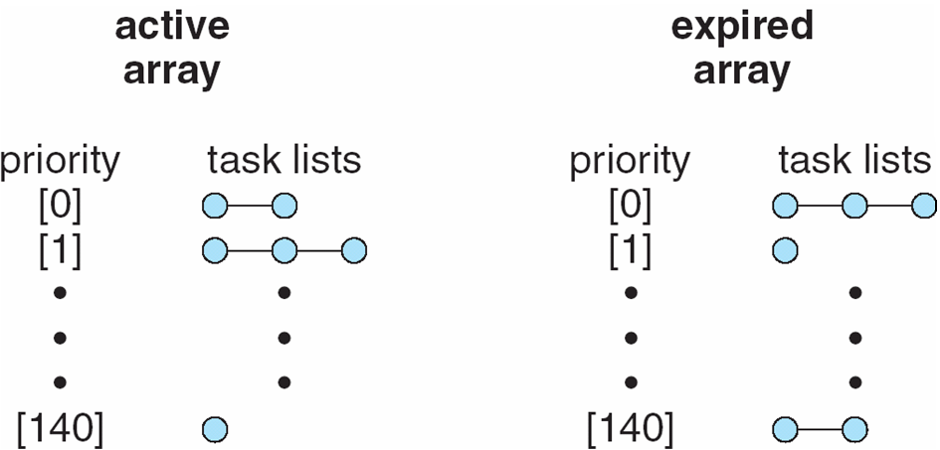
List of Tasks Indexed
According to Priorities

Slide 50
Algorithm Evaluation
How to select CPU-scheduling algorithm for an OS?
Determine criteria, then evaluate algorithms
Deterministic modeling
  Type of analytic evaluation
  Takes a particular predetermined workload and defines the performance of each algorithm for that workload

Slide 51
Queueing Models
Describes the arrival of processes, and CPU and I/O bursts probabilistically
  Commonly exponential, and described by mean
  Computes average throughput, utilization, waiting time, etc
Computer system described as network of servers, each with queue of waiting processes
  Knowing arrival rates and service rates
  Computes utilization, average queue length, average wait time, etc

Slide 52
Little’s Formula
n = average queue length
W = average waiting time in queue
λ = average arrival rate into queue
Little’s law – in steady state, processes leaving queue must equal processes arriving, thus
n = λ x W
  Valid for any scheduling algorithm and arrival distribution
For example, if on average 7 processes arrive per second, and normally 14 processes in queue, then average wait time per process = 2 seconds

Slide 53
Simulations
Queueing models limited
Simulations more accurate
  Programmed model of computer system
  Clock is a variable
  Gather statistics indicating algorithm performance
  Data to drive simulation gathered via
    Random number generator according to probabilities
    Distributions defined mathematically or empirically
    Trace tapes record sequences of real events in real systems

Slide 54
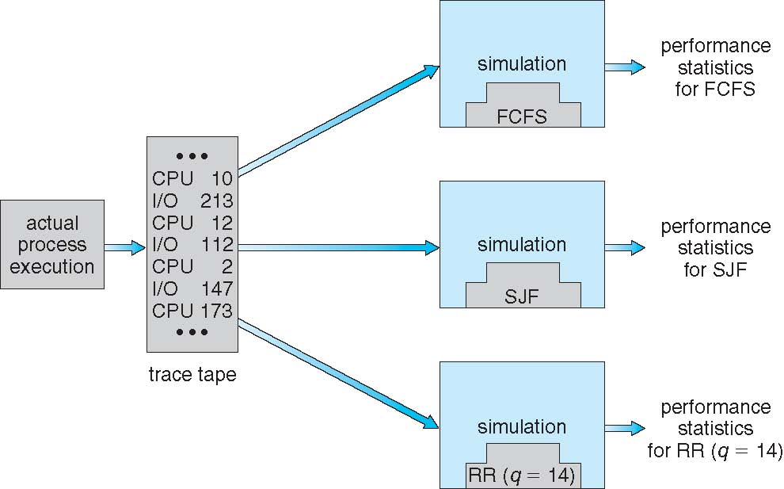
Evaluation of CPU Schedulers by Simulation

Slide 55
Implementation
Even simulations have limited accuracy
Just implement new scheduler and test in real systems
  High cost, high risk
  Environments vary
Most flexible schedulers can be modified per-site or per-system
Or APIs to modify priorities
But again environments vary

Slide 56
End of Chapter 5

Slide 57
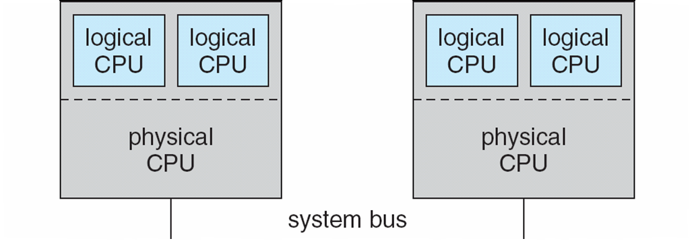
5.08

Slide 58
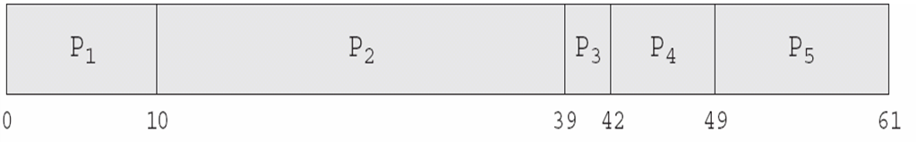
In-5.7

Slide 59
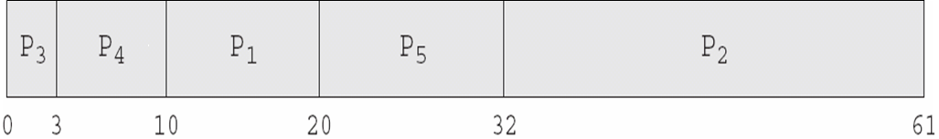
In-5.8

Slide 60

In-5.9

Slide 61

Dispatch Latency

Slide 62
Java Thread Scheduling
JVM Uses a Preemptive, Priority-Based Scheduling Algorithm
FIFO Queue is Used if There Are Multiple Threads With the Same Priority

Slide 63
Java Thread Scheduling (Cont.)
JVM Schedules a Thread to Run When:
  The Currently Running Thread Exits the Runnable State
  A Higher Priority Thread Enters the Runnable State
* Note – the JVM Does Not Specify Whether Threads are Time-Sliced or Not

Slide 64
Time-Slicing
Since the JVM Doesn’t Ensure Time-Slicing, the yield() Method
May Be Used:
while (true) {
// perform CPU-intensive task
. . .
Thread.yield();
}
This Yields Control to Another Thread of Equal Priority

Slide 65
Thread Priorities
Priority Comment
Thread.MIN_PRIORITY Minimum Thread Priority
Thread.MAX_PRIORITY Maximum Thread Priority
Thread.NORM_PRIORITY Default Thread Priority
Priorities May Be Set Using setPriority() method:
setPriority(Thread.NORM_PRIORITY + 2);

Slide 66
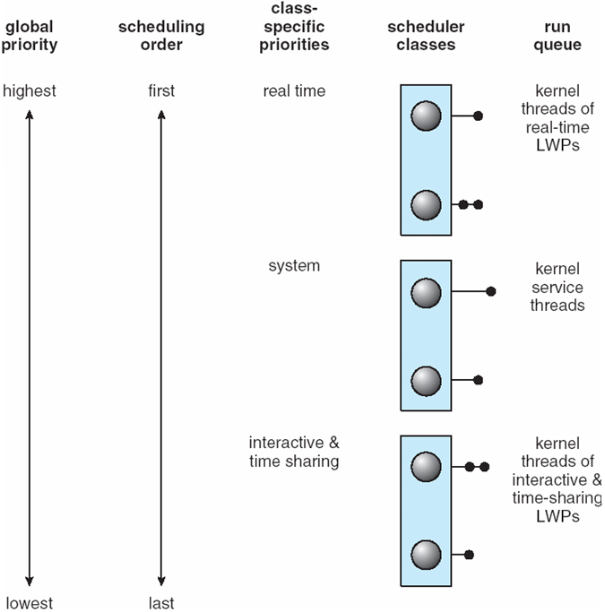
Solaris 2 Scheduling

